Slide 1
Transfer learning

Slide 2
Real-life challenges in life
Deep learning methods are data-hungry
>50K data items needed for training
The distributions of the source and target data must be the same
Labeled data in the target domain may be limited
This problem is typically addressed with transfer learning

Slide 3
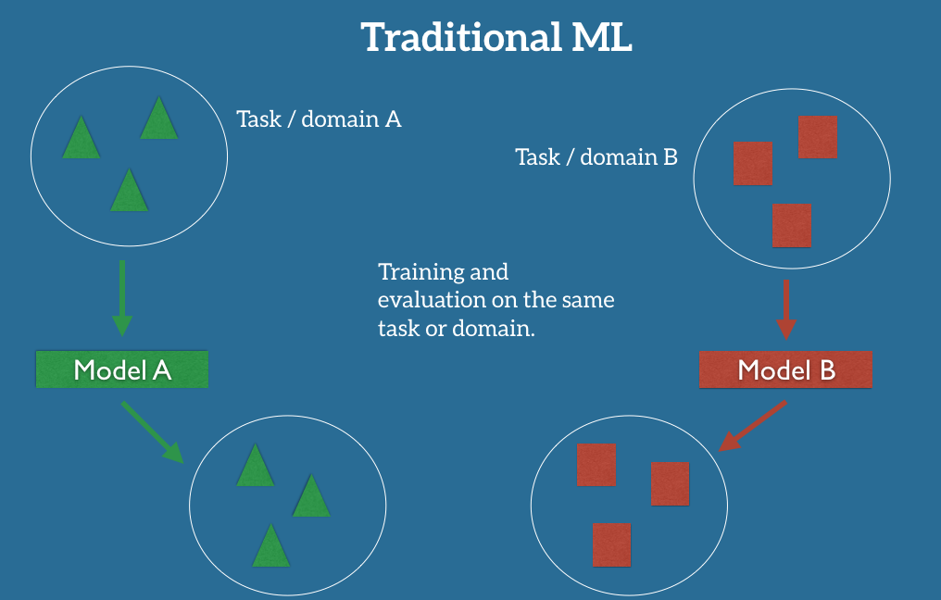
Traditional ML
Notes:
The traditional supervised learning paradigm breaks down when we do not have sufficient labeled data for the task or domain we care about to train a reliable model.

Slide 4
Traditional ML
Task: the objective our model aims to perform
(e.g., recognize activities, cook, eat, sleep).
Domain: where our data is coming from
(e.g., image data from my home)
Notes:
The traditional supervised learning paradigm breaks down when we do not have sufficient labeled data for the task or domain we care about to train a reliable model.

Slide 5
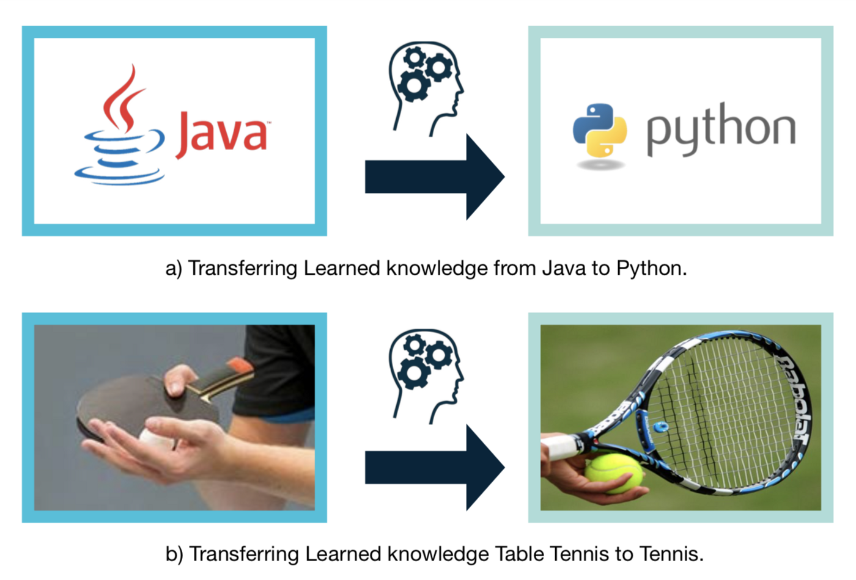
Transfer learning Examples
Notes:
Learning of a new task that is relied on the previous learned tasks.
Why? Learning process can be faster, more accurate and / or need less training data
If we want to train a model to detect pedestrians on night-time images, we could apply a model that has been trained on a similar domain, e.g. on day-time images. In practice, however, we often experience a deterioration or collapse in performance as the model has inherited the bias of its training data and does not know how to generalize to the new domain. If we want to train a model to perform a new task, such as detecting bicyclists, we cannot even reuse an existing model, as the labels between the tasks differ.
Transfer learning allows us to deal with these scenarios by leveraging the already existing labeled data of some related task or domain. We try to store this knowledge gained in solving the source task in the source domain and apply it to our problem of interest

Slide 6
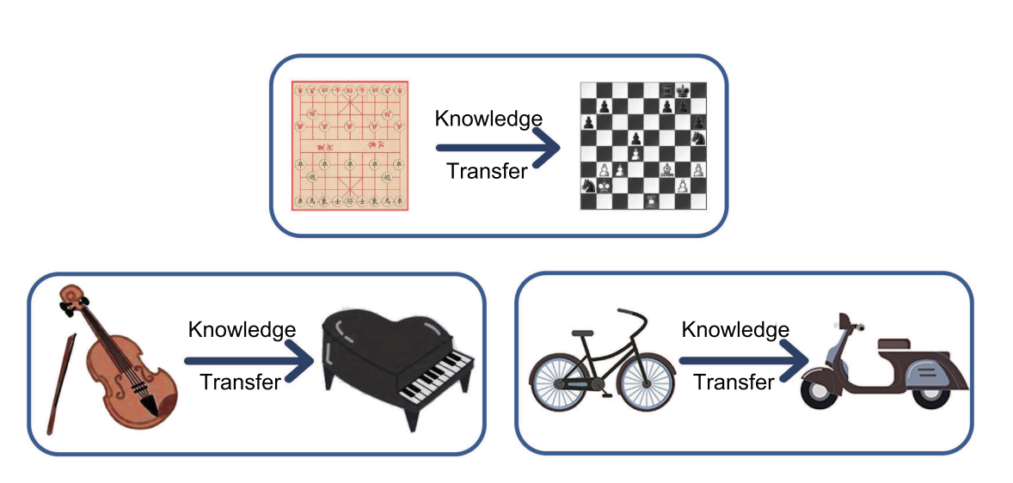
Transfer learning Examples
Notes:
Learning of a new task that is relied on the previous learned tasks.
Why? Learning process can be faster, more accurate and / or need less training data
If we want to train a model to detect pedestrians on night-time images, we could apply a model that has been trained on a similar domain, e.g. on day-time images. In practice, however, we often experience a deterioration or collapse in performance as the model has inherited the bias of its training data and does not know how to generalize to the new domain. If we want to train a model to perform a new task, such as detecting bicyclists, we cannot even reuse an existing model, as the labels between the tasks differ.
Transfer learning allows us to deal with these scenarios by leveraging the already existing labeled data of some related task or domain. We try to store this knowledge gained in solving the source task in the source domain and apply it to our problem of interest

Slide 7
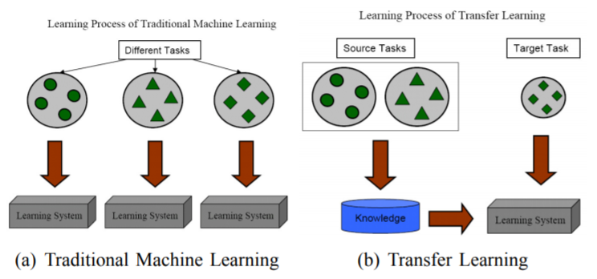
Transfer Learning

Slide 8
What is Transfer Learning
Learning of a new task that is relied on the previous learned tasks.
Good parts of using transfer learning
Learning process can be faster
more accurate
need less training data

Slide 9
Questions about transfer
Which part of the knowledge can be transferred from the source to the target to improve the performance of the target task?
When to transfer and when not to, so that one improves the target task performance/results and does not degrade them?
How to transfer the knowledge gained from the source model based on our current domain/task?

Slide 10
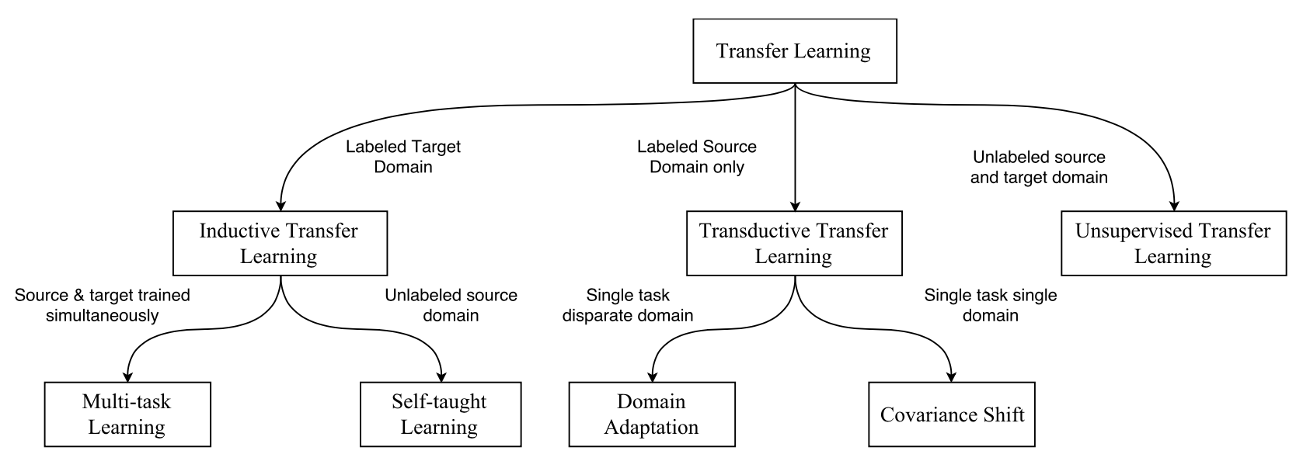
Transfer Learning Approaches
Source: https://arxiv.org/pdf/1802.05934.pdf
Notes:
Inductive transfer learning: labeled source instances are available
transfer learning strategies fall under three major categories depending upon the task domain and the amount of labeled/unlabeled data present.

Slide 11
Transfer Learning
Inductive transfer learning
Transductive transfer learning
Unsupervised transfer learning

Slide 12
Inductive transfer learning
Same: the source and target domains to be the same
Different: the specific tasks
How:
use the knowledge from the source model and apply it to improve the target task.
the pre-trained model already has expertise on the features of the domain

Slide 13
Inductive transfer learning
two subcategories:
Source domain has labels:
multi-task learning
Source domain without labels:
self-taught learning

Slide 14
Transfer Learning
Inductive transfer learning
Transductive transfer learning
Unsupervised transfer learning

Slide 15
Transductive transfer learning
Same: similar tasks
Different: domains
Cases:
no labeled data exists in the target domain
while a lot of labeled data exists in the source domain

Slide 16
Transductive transfer learning
Two subcategories:
Covariance shift:
Feature spaces between the source and target domains can be different
Domain adaptation:
Feature spaces between domains are the same but the marginal probability distributions of the input data are different.

Slide 17
Transfer Learning
Inductive transfer learning
Transductive transfer learning
Unsupervised transfer learning

Slide 18
Unsupervised transfer learning
Same: domains
Different: tasks
Cases:
No labeled data in either of the domains
Solve unsupervised learning tasks in the target domain, such as clustering, or dimensionality reduction

Slide 19
Transfer Learning Approaches
Notes:
Inductive transfer learning: labeled source instances are available
transfer learning strategies fall under three major categories depending upon the task domain and the amount of labeled/unlabeled data present.

Slide 20
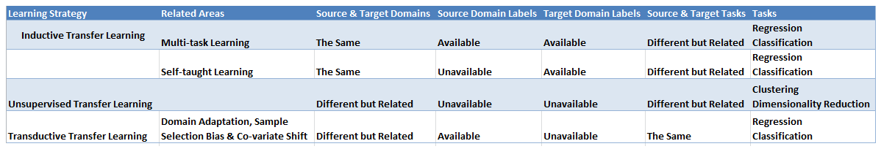
Summary of three types of transfer learning

Slide 21
Questions about transfer
Which part of the knowledge can be transferred from the source to the target to improve the performance of the target task?
When to transfer and when not to, so that one improves the target task performance/results and does not degrade them?
How to transfer the knowledge gained from the source model based on our current domain/task?

Slide 22
What to transfer
Instance transfer:
Reusing knowledge / certain instances from the source domain to the target task by re-weighting
Feature-representation transfer:
Identify good feature representations that can be utilized from the source to target domains
minimize domain divergence and reduce error rates
Parameter transfer:
the models for related tasks share some parameters or prior distribution of hyperparameters
Relational-knowledge transfer:
handle non-IID data

Slide 23
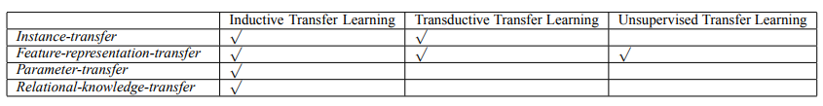
What to transfer

Slide 24
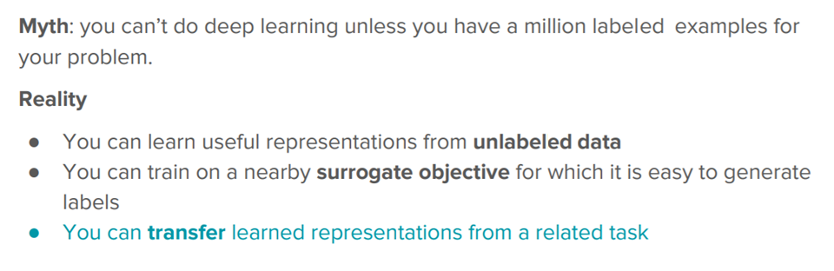
Transfer learning in deep learning

Slide 25
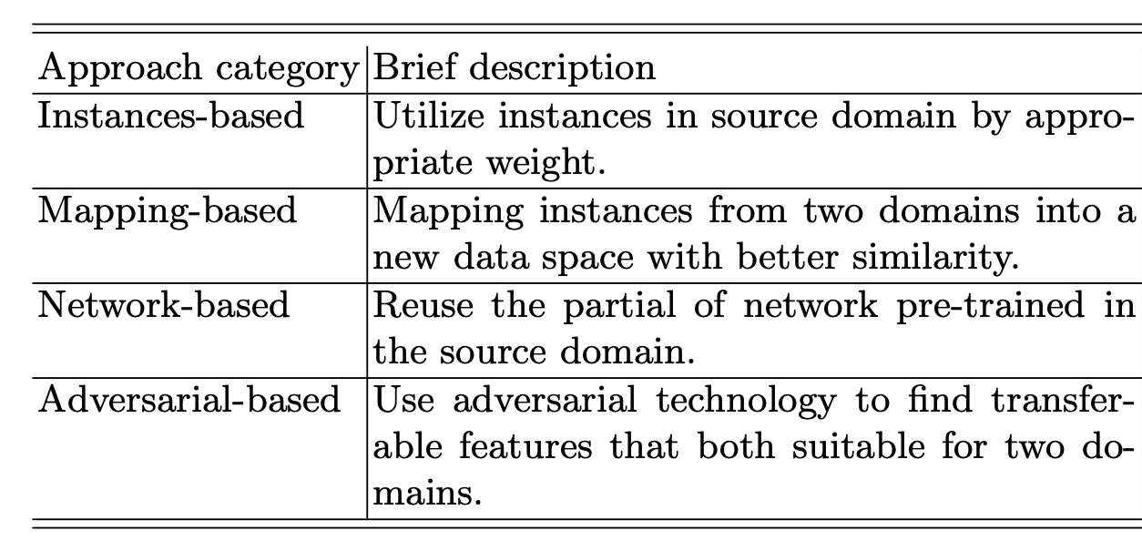
Transfer learning in deep learning

Slide 26
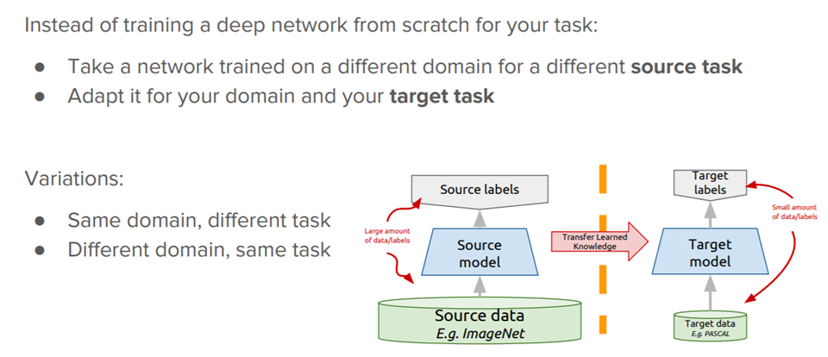
Deep Transfer Learning

Slide 27
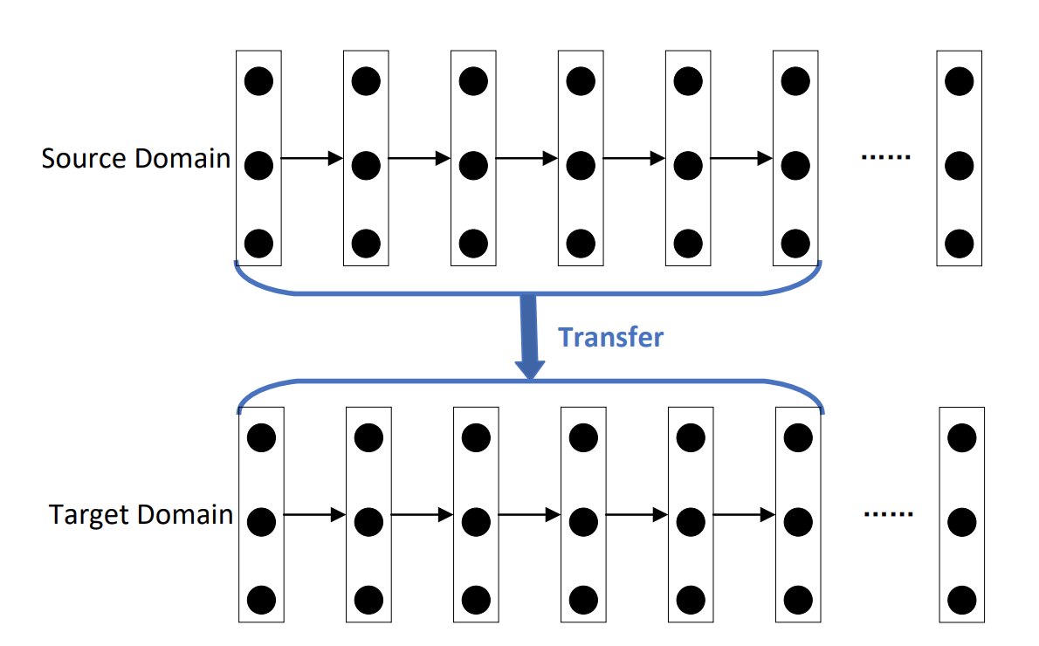
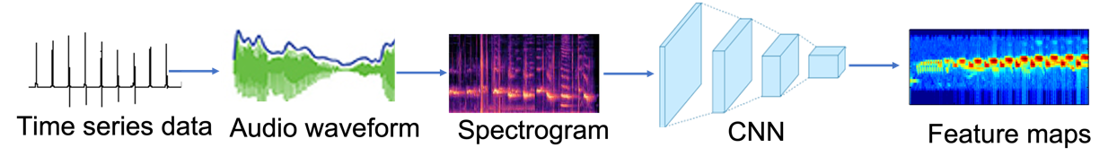
Source Labels
(e.g, airport, street)
Target Labels
(e.g, airport, university campus)
Transfer knowledge
Target model
Source model
Source data
e.g., TAU Urban Acoustic Scenes
Target data
e.g., from UNLV

Slide 28
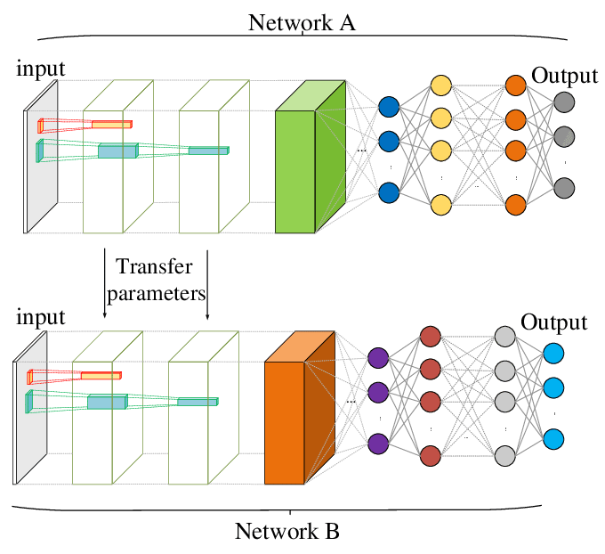
Source model
Source data
e.g., TAU Urban Acoustic Scenes
Source Labels
(e.g, airport, street)
Target Labels
(e.g, airport, university campus)
Target data
e.g., from UNLV
Target model
Figure 2. Transfer the knowledge learned from the source data to the target model.

Slide 29
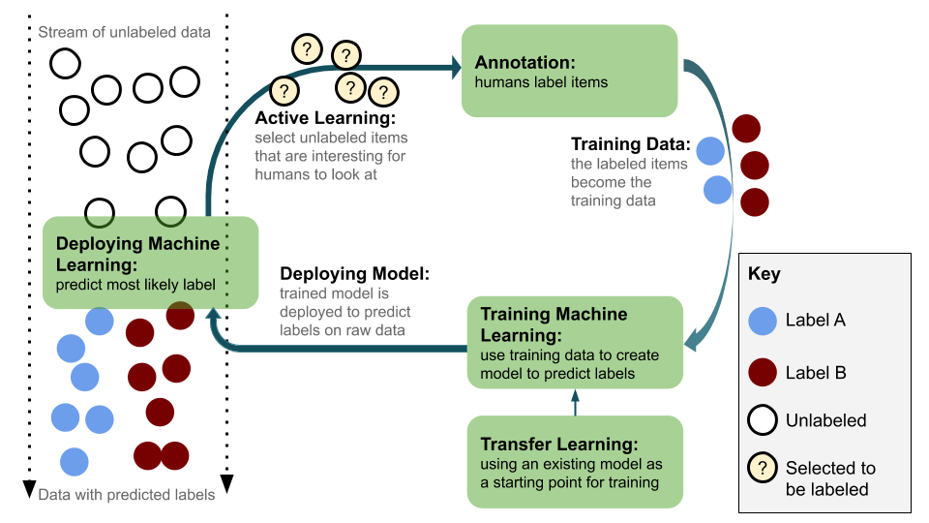

Slide 30
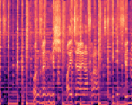
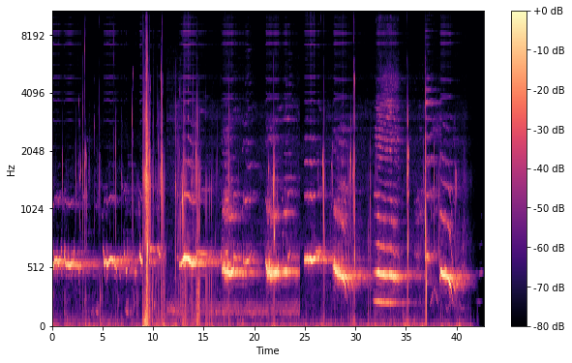
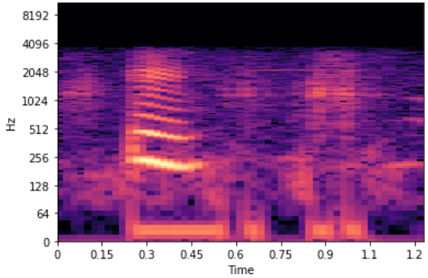
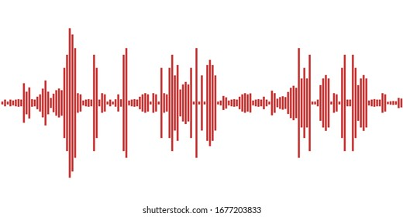
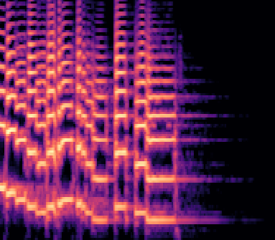
unlabeled
audio data
unlabeled
spectrograms
Active Learning
Human annotation
select unlabeled data
ask for human labeling
Training data
Put the labeled data
into training dataset
Deploy AI method
Deploy model
Use the trained model
to predict labels of data
Train model
use training data to create a model for label prediction
Convert audio data
to spectrograms
Transfer Learning in Task 2
Use model based on source data
to start with training
labeled
audio data
labeled
spectrograms
Figure 3. Transfer Learning based Active Learning for Spectrograms

Slide 31
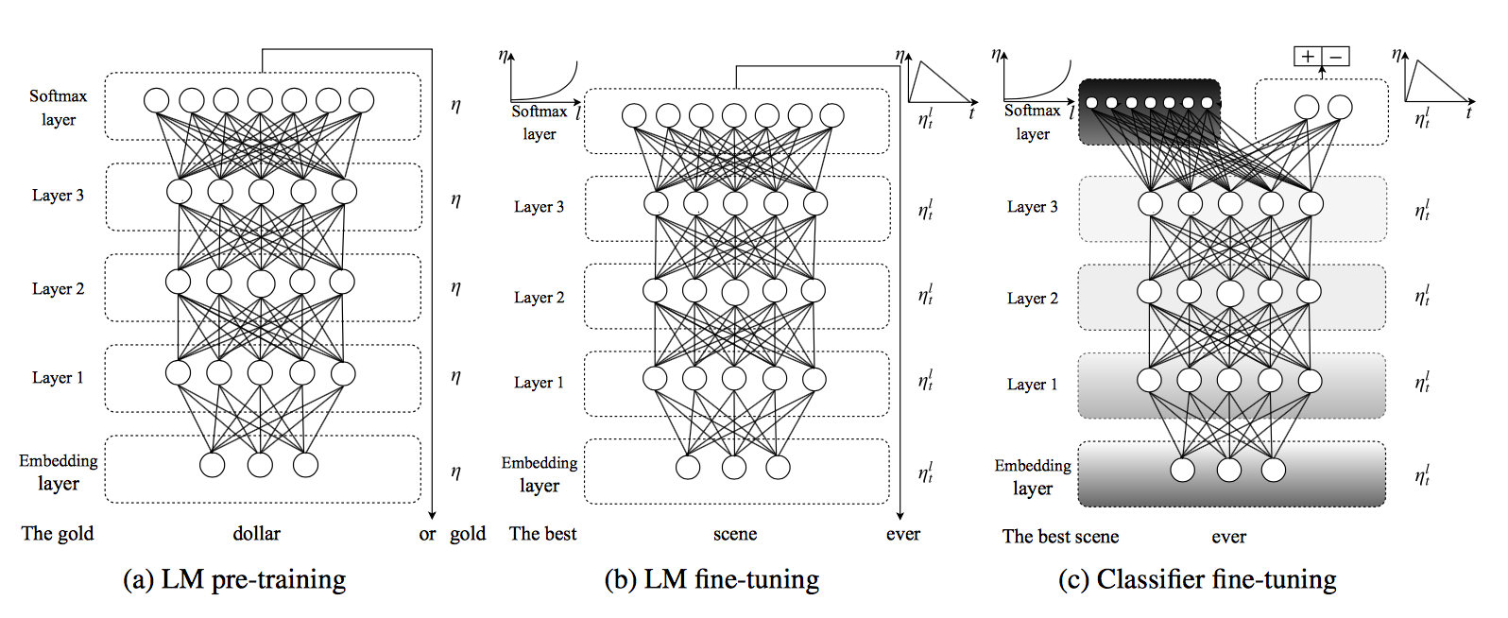

Slide 32
Network-based Deep Transfer Learning
Network was trained in source domain with large-scale training dataset.
2. transfer partial of network pretrained for source domain to be a part of new network designed for target domain
3. Update the transferred sub-network in fine-tune strategy.

Slide 33
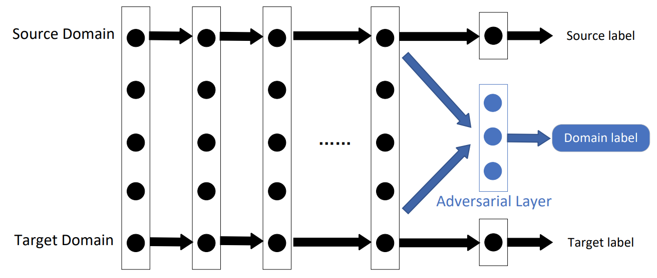
Adversarial-based Deep Transfer Learning
Extract features from two domains
3. Discriminate the origin of the features
2. Send them to adversarial layer
If the adversarial network achieves worse performance
=> a small difference between the two types of feature.

Slide 34
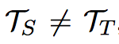
Fine Tuning
Inductive transfer setting:
Given a static source task and any target task with we would like to improve the performance on
Pre-train a model (LM) on a large general-domain corpus
Fine-tune it on the target task using novel techniques
The method is universal
Works across tasks varying in document size, number and label type
Uses single architecture and training process
Requires no custom feature engineering or pre-processing
Does not require additional in-domain documents or labels

Slide 35
Step 1: General domain model pre-training

Slide 36
General domain model pre-training
Used AvSGD Weight-Dropped LSTM (AWD-LSTM, Merity et al. 2017)
model pre-trained on Wikitext-103 (103M words)
Expensive, but performed only once
Improves performance and convergence of downstream tasks
Notes:
“Pretraining is most beneficial for tasks with small datasets and enables generalization even with 100 labeled examples.”

Slide 37
Step 2: Target task model pre-training

Slide 38
Target task model fine-tuning
Data for the target task is likely from a different distribution
Fine-tune the model on data of the target task
This stage converges faster
Allows to train a robust model even on small datasets
Two approaches to fine-tuning:
Discriminative fine-tuning
Slanted triangular learning rates

Slide 39
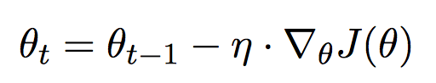
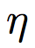
Discriminative fine-tuning
Different layers capture different types of information, hence, they should be fine-tuned to different extents
Instead of using one learning rate for all layers, tune each layer with different learning rates.
Regular Stochastic Gradient Descent (SGD):
where is the learning rate and is the gradient with regard to the model’s objective function

Slide 40
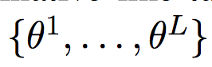
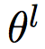
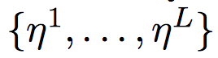
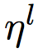
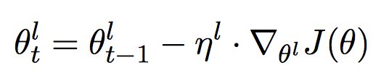
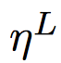
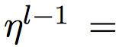
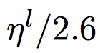
Discriminative fine-tuning (cont.)
Discriminative fine-tuning:
Split parameters into where contains the parameters of the model at the 𝑙-th layer and 𝑳 is the number of layers of the model
Obtain where is the learning rate of the 𝑙-th layer
SGD update with discriminative fine-tuning:
Fine tune the last layer and use as the learning rate for lower layers

Slide 41
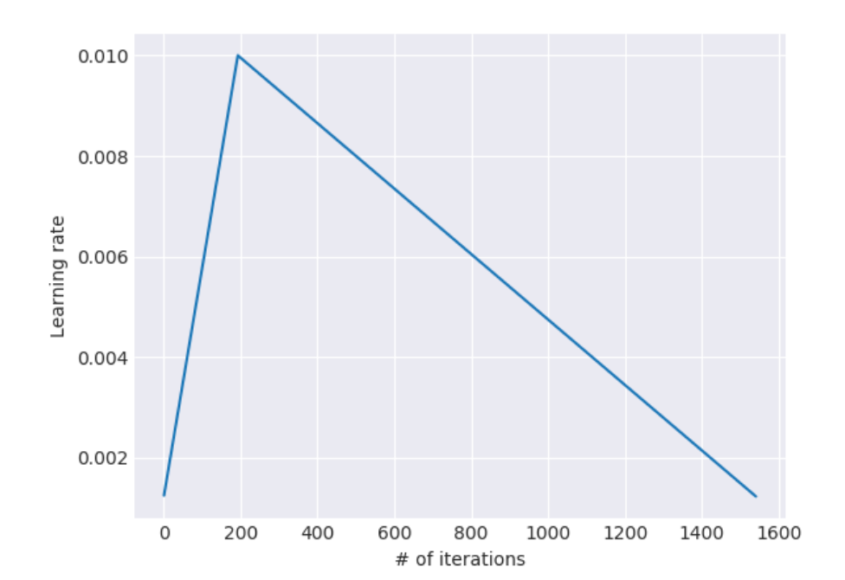
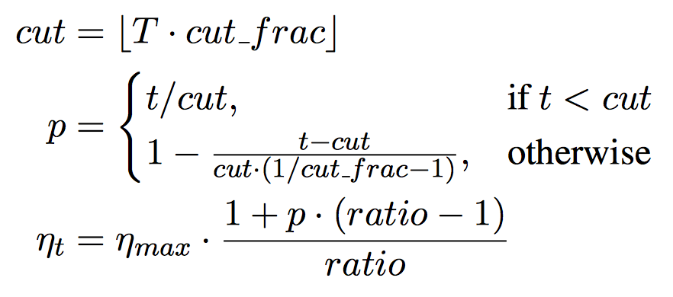
Slanted triangular learning rates (STLR)
Intuition for adapting parameters to task-specific features:
At the beginning of training: quickly converge to a suitable region of the parameter space
Later during training: refine the parameters
Notes:
T is the number of training iterations
cut_frac is the fraction of iterations we increase the LR
cut is the iteration when we switch from increasing to decreasing the LR
p is the fraction of the number of iterations we have increased or will decrease the LR respectively
ratio specifies how much smaller the lowest LR is from the maximum LR η_{max}
η_{t} tis the learning rate at iteration t.

Slide 42
Step 3: Target task classifier fine-tuning

Slide 43
Target task classifier fine-tuning
Augment the pre-trained model with two additional linear layers:
ReLU activations in the intermediate layer
Softmax as the last layer
These are the only layers, whose parameters are learned from scratch
First layer takes as input the pooled last hidden layer states

Slide 44
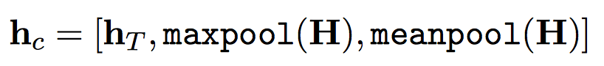
Concat pooling
Input sequences may consist of hundreds of words → information may get lost if we only use the last hidden state of the model
Concatenate the hidden state at the last time step h_{T} of the document with:
Max-pooled representation of the hidden states
Mean-pooled representation of the hidden states
over as many time steps as fit in GPU memory H = {h₁, ..., h_{T}}:
where [] is concatenation

Slide 45
Fine-tuning Procedure – Gradual Unfreezing
Overly aggressive fine-tuning causes catastrophic forgetting
Too cautious fine-tuning leads to slow convergence and overfitting
Proposed approach: gradual unfreezing
First unfreeze the last layer and fine-tune the unfrozen layer for one epoch
Then unfreeze the next lower frozen layer and fine-tune all unfrozen layers
Repeat until we fine-tune all layers until convergence in the last iteration
The combination of discriminative fine-tuning, slanted triangular learning rates and gradual unfreezing leads to best performance

Slide 46
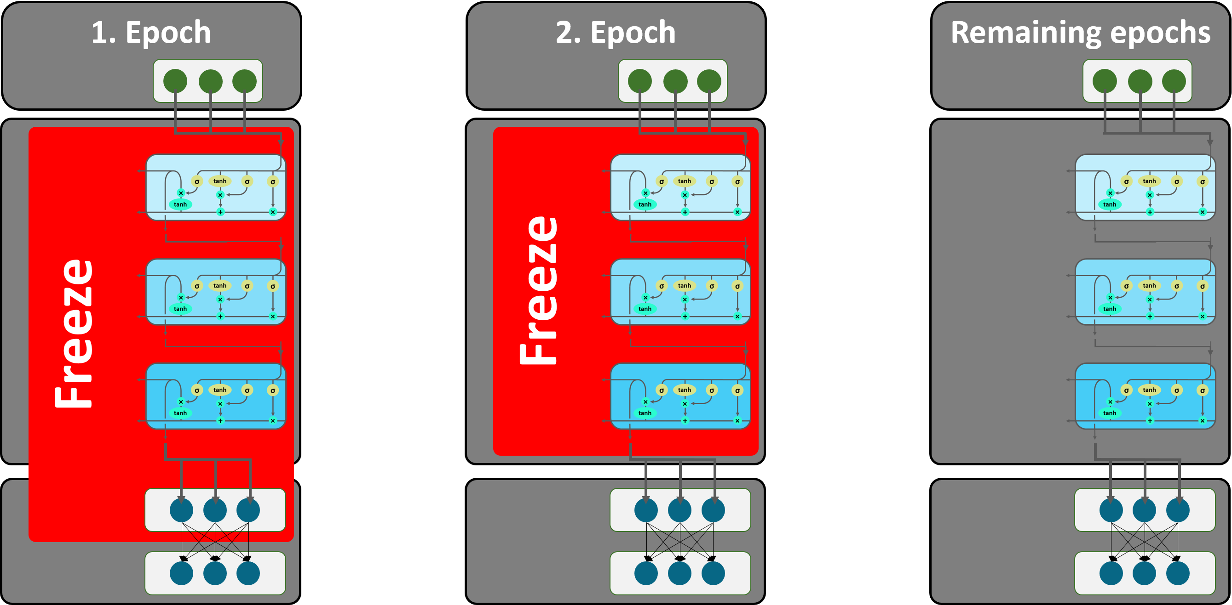
Fine-tuning Procedure – Gradual Unfreezing

Slide 47
Experiments 1. several thousand images of cats and dogs

Slide 50
Transductive transfer learning
Two subcategories:
Covariate shift:
Feature spaces between the source and target domains can be different
Domain adaptation:
Feature spaces between domains are the same but the marginal probability distributions of the input data are different.

Slide 51
Transductive vs Inductive Transfer Learning
Transductive transfer
No labeled target domain data available
Focus of most transfer research in NLP
E.g. Domain adaptation
Inductive transfer
Labeled target domain data available
Goal: improve performance on the target task by training on other task(s)
Jointly training on >1 task (multi-task learning)
Pre-training (e.g. word embeddings)

Slide 52
Pre-training – Word Embeddings
Pre-trained word embeddings have been an essential component of most deep learning models
Problems with pre-trained word embeddings:
Shallow approaches – trade expressivity for efficiency
Learned word representations are not context sensitive
No distinction between senses
Only the first layer (embedding layer) of the model is pre-trained
The rest of the model must be trained from scratch

Slide 53
Recent paradigm shift in pre-training for NLP
Inspired by the success of models pre-trained on ImageNet in Computer Vision (CV)
The use of models pre-trained on ImageNet is now standard in CV

Slide 54
Recent paradigm shift in pre-training for NLP
What is a good equivalent of an ImageNet task in NLP?
Key desiderata:
An ImageNet-like dataset should be sufficiently large, i.e. on the order of millions of training examples.
It should be representative of the problem space of the discipline.
Contenders to that role:
Reading Comprehension (SQuaD dataset, 100K Q-A pairs)
Natural Language Inference (SNLI corpus, 570K sentence pairs)
Machine Translation (WMT 2014, 40M French-English sentence pairs)
Constituency parsing (millions of weakly labeled parses)
Language Modeling (unlimited data, current benchmark dataset: 1B words http://www.statmt.org/lm-benchmark/)
Source: https://thegradient.pub/nlp-imagenet/

Slide 55
The case for Language Modeling
LM captures many aspects of language:
Long-term dependencies
Hierarchical relations
Sentiment
Etc.
Training data is unlimited

Slide 56
LM as pre-training – Approaches
Embeddings from Language Models (ELMo) (Peters et al., 2018)
Universal Language Model Fine-tuning (ULMFiT) (Howard and Ruder, 2018)
OpenAI Transformer (Radford et al., 2018)
Overview of the above approaches: https://thegradient.pub/nlp-imagenet/

Slide 57
Universal Language Model Fine Tuning for Text Classification
Jeremy Howard and Sebastian Ruder
In Proc. ACL, 2018
Paper: https://arxiv.org/pdf/1801.06146.pdf
Code: http://nlp.fast.ai/category/classification.html

Slide 58
Approach
Inductive transfer setting:
Given a static source task and any target task with we would like to improve the performance on
Pre-train a language model (LM) on a large general-domain corpus
Fine-tune it on the target task using novel techniques
The method is universal
Works across tasks varying in document size, number and label type
Uses single architecture and training process
Requires no custom feature engineering or pre-processing
Does not require additional in-domain documents or labels

Slide 59
Steps

Slide 60
Step 1: General domain LM pre-training

Slide 61
General domain LM pre-training
Used AvSGD Weight-Dropped LSTM (AWD-LSTM, Merity et al. 2017)
LM pre-trained on Wikitext-103 (103M words)
Expensive, but performed only once
Improves performance and convergence of downstream tasks
Notes:
“Pretraining is most beneficial for tasks with small datasets and enables generalization even with 100 labeled examples.”

Slide 62
Step 2: Target task LM pre-training

Slide 63
Target task LM fine-tuning
Data for the target task is likely from a different distribution
Fine-tune the LM on data of the target task
This stage converges faster
Allows to train a robust LM even on small datasets
Two approaches to fine-tuning:
Discriminative fine-tuning
Slanted triangular learning rates

Slide 64
Discriminative fine-tuning
Different layers capture different types of information, hence, they should be fine-tuned to different extents
Instead of using one learning rate for all layers, tune each layer with different learning rates.
Regular SGD:
where is the learning rate and is the gradient with regard to the model’s objective function

Slide 65
Discriminative fine-tuning (cont.)
Discriminative fine-tuning:
Split parameters into where contains the parameters of the model at the 𝑙-th layer and 𝑳 is the number of layers of the model
Obtain where is the learning rate of the 𝑙-th layer
SGD update with discriminative fine-tuning:
Fine tune the last layer and use as the learning rate for lower layers

Slide 66
Slanted triangular learning rates (STLR)
Intuition for adapting parameters to task-specific features:
At the beginning of training: quickly converge to a suitable region of the parameter space
Later during training: refine the parameters
Notes:
T is the number of training iterations
cut_frac is the fraction of iterations we increase the LR
cut is the iteration when we switch from increasing to decreasing the LR
p is the fraction of the number of iterations we have increased or will decrease the LR respectively
ratio specifies how much smaller the lowest LR is from the maximum LR η_{max}
η_{t} tis the learning rate at iteration t.

Slide 67
Step 3: Target task classifier fine-tuning

Slide 68
Target task classifier fine-tuning
Augment the pre-trained language model with two additional linear layers:
ReLU activations in the intermediate layer
Softmax as the last layer
These are the only layers, whose parameters are learned from scratch
First layer takes as input the pooled last hidden layer states

Slide 69
Concat pooling
Input sequences may consist of hundreds of words → information may get lost if we only use the last hidden state of the model
Concatenate the hidden state at the last time step h_{T} of the document with:
Max-pooled representation of the hidden states
Mean-pooled representation of the hidden states
over as many time steps as fit in GPU memory H = {h₁, ..., h_{T}}:
where [] is concatenation

Slide 70
Fine-tuning Procedure – Gradual Unfreezing
Overly aggressive fine-tuning causes catastrophic forgetting
Too cautious fine-tuning leads to slow convergence and overfitting
Proposed approach: gradual unfreezing
First unfreeze the last layer and fine-tune the unfrozen layer for one epoch
Then unfreeze the next lower frozen layer and fine-tune all unfrozen layers
Repeat until we fine-tune all layers until convergence in the last iteration
The combination of discriminative fine-tuning, slanted triangular learning rates and gradual unfreezing leads to best performance

Slide 71
Experiments

Slide 72
Tasks and Datasets
Sentiment analysis: binary (positive-negative) classification; the IMDb movie review dataset
Question classification: broad semantic categories; small TREC dataset
Topic classification: large-scale AG news and DBPedia ontology datasets

Slide 73
Results

Slide 74
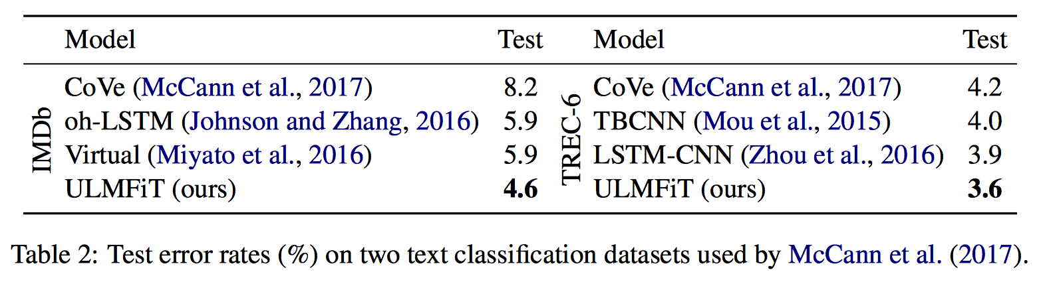
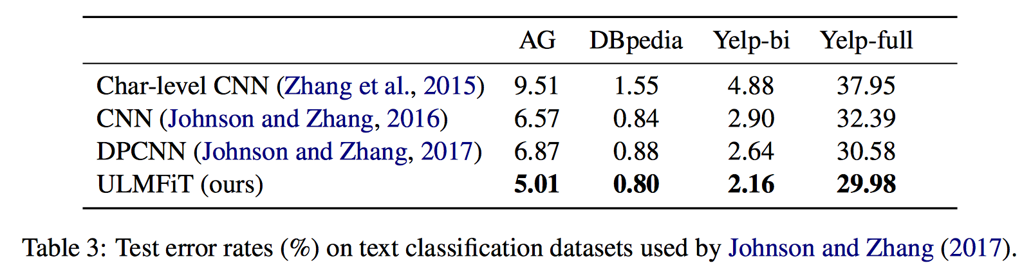
Evaluation measure: error rate (lower is better)

Slide 75
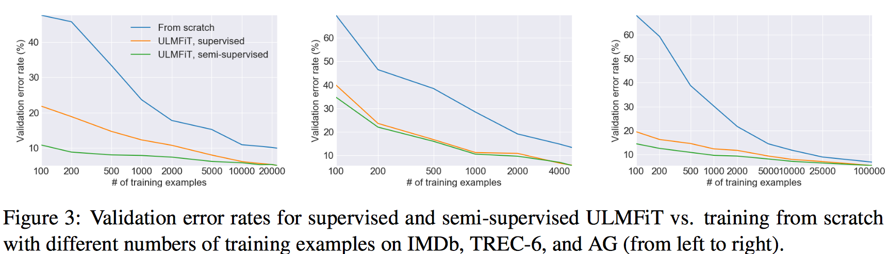
Analysis
Low-shot learning – training a model for a task with small number of labeled samples

Slide 76
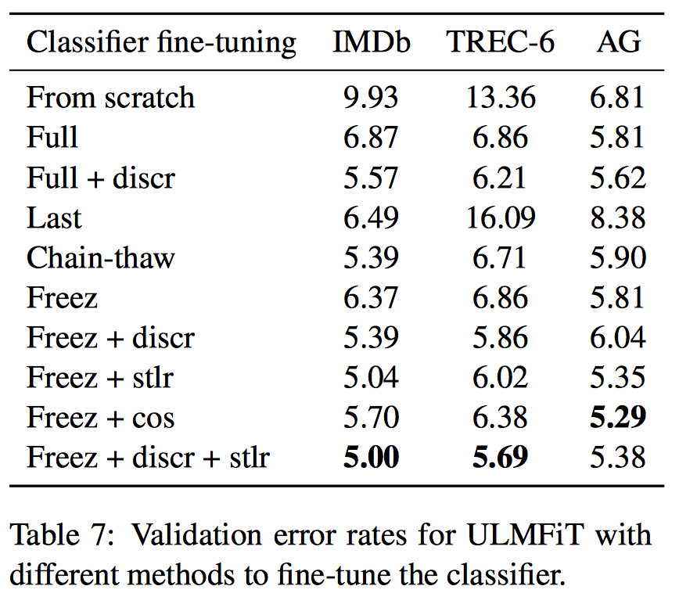
Different methods to fine-tune the classifier
Notes:
“Impact of classifier fine-tuning. We compare training from scratch, fine-tuning the full model (‘Full’), only fine-tuning the last layer (‘Last’) (Donahue et al.,2014), ‘Chain-thaw’ (Felbo et al.,2017), and gradual unfreezing (‘Freez’). We furthermore assess the importance of discriminative fine-tuning (‘Discr’) and slanted triangular learning rates (‘Stlr’). We compare the latter to an alternative, aggressive cosine annealing schedule (‘Cos’) (Loshchilov and Hutter,2017).”

Slide 77
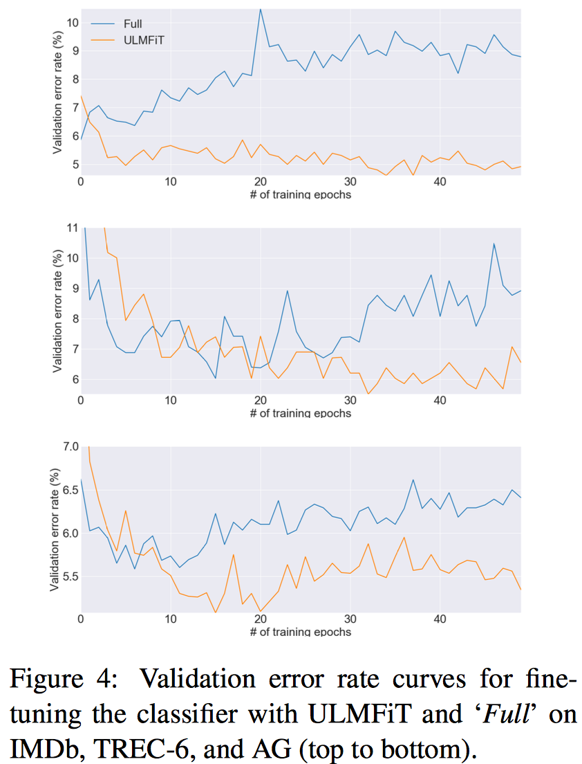
“Full” vs ULMFiT

Slide 78
Conclusions
ULMFiT is useful for a variety of tasks (different datasets, sizes, domains)
Proposed approach to fine-tuning prevents catastrophic forgetting of knowledge learned during pre-training
Achieves good results even with 100 training data items
Generally LM pre-training and task-specific fine-tuning will be useful for scenarios where:
Training data is limited
New NLP tasks where no state-of-the-art architecture exists

Slide 79
Future work
Augment LM with additional tasks (i.e. multi-task learning setting)
Other tasks (entailment or QA) may require novel ways to pre-train and fine-tune
Need to understand better:
What knowledge a pre-trained model captures
How it changes during fine-tuning
What information different tasks require

